Slide 1

Teacher Evaluation Presentation
Scott Poirier
K-12 Education Coordinator, WEA
spoirier@washingtonea.org

Slide 2
Evaluation Timeline
2010
2011
2012
2013
ESSB 5895
New Evaluation for State
SB 6696
RIGs
TPEP Pilots
ESEA Waiver

Slide 3
Criteria | 1 Unsatisfactory |  | 2 Basic |  | 3 Proficient | 4 Distinguished
Criterion 1
Criterion 2
Criterion 3
Criterion 4
Criterion 5
Criterion 6
Criterion 7
Criterion 8
Cut Score changes 0-5 years between Unsat & Basic 5+ years between basic and proficient
Have to score all eight
Three Instructional Frameworks CEL 5D’s+, Danielson, Marzano
Final Summative Evaluation | 1 Unsatisfactory |  | 2 Basic |  | 3 Proficient | 4 Distinguished
Final Summative Descriptors | Teachers do not demonstrate the necessary content knowledge, pedagogical competence, and professional practice required to improve student learning. Does not meet standard |  | Teachers demonstrate a basic level of content knowledge, pedagogical competence, and professional practice to improve student learning. Teachers in this category also engage in activities designed for improvement and growth towards becoming proficient. |  | Teachers rated in this category consistently demonstrate a proficient level of content knowledge, pedagogical competence, and professional practice to improve student learning. | Teachers rated in this category consistently demonstrate an exceptional level of content knowledge, pedagogical competence, and professional practice to improve student learning.

Slide 4
Comprehensive Raw Score Calculations - Preliminary
Determining Overall Criterion Score Teaching Criteria | Overall Score
Criterion 1: Centering instruction on high expectations for student achievement | 3
Criterion 2: Demonstrating effective teaching practices | 4
*Criterion 3: Recognizing individual student learning needs and developing strategies to address those needs | 3
Criterion 4: Providing clear and intentional focus on subject matter content and curriculum | 2
Criterion 5: Fostering and managing a safe, positive learning environment | 3
*Criterion 6: Using multiple student data elements to modify instruction and improve student learning | 2
Criterion 7: Communicating and collaborating with parents and school community | 3
*Criterion 8: Exhibiting collaborative and collegial practices focused on improving instructional practice and student learning | 2
Total Summative Score | 22
The evaluator places teachers into categories based on score bands.
As illustrated below, this teacher (scored a 22) would receive an overall summative rating of Proficient.
8-14 | 15-21 | 22-28 | 29-32
1 Unsatisfactory | 2 Basic | 3 Proficient | 4 Distinguished

Slide 5

ESSB 5895: Language In Evaluation Bill
Student Growth Data Section 1, 2(b) (f) (g) Section 1, 6 (g): Student Growth Data that is relevant to the teacher and subject matter must be a factor in evaluations and must be multiple measures.
It must be used in at least three of the eight teacher and principal evaluation criteria. ESEA waiver - Criterion 3,6 & 8
Student growth - Growth between two points in time
Multiple measures – can include classroom, school, district or state-based measures
May include the teacher’s performance as an individual or as a member of a team.

Slide 6
1. Centering instruction on high expectations
2. Demonstrating effective teaching practices
3. Recognizing individual student learning needs and developing strategies to address those needs
4. Subject matter knowledge
5. Fostering a safe, positive learning environment
6. Using multiple student data elements to modify instruction and improve student learning
7. Communicating with parents and school community
8. Exhibiting collaborative and collegial practices focused on improving instructional practice and student learning
TEACHER
EVALUATION
CRITERIA

Slide 7


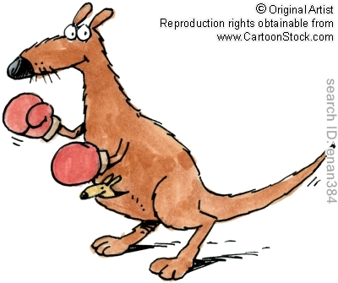
And in This Corner: Student Achievement VS. Student Learning
Student Achievement: Student Achievement is the status of subject-matter knowledge, understandings, and skills at one point in time.
Student Learning: Student learning is the growth in subject-matter knowledge, understandings, and skills over time.
In essence, it is an increase in achievement over time that constitutes learning. It is only by comparing student achievement at successive points in time that the nature and extent of learning can be gauged.
It is student learning—not student achievement—that is relevant in demonstrating impacts teachers have on students.

Slide 8
Student growth Rubric Language
Criterion 3 | Criterion 6 | Criterion 8
SG 3.1 Establishes appropriate student growth goals for subgroups of students not reaching full learning potential. Goals identify multiple, high-quality sources of data to monitor, adjust, and evaluate achievement of goals. | SG 6.1 Establishes appropriate student growth goals for whole classroom. Goals identify multiple, high quality sources of data to monitor, adjust, and evaluate achievement of goals. | SG 8.1 Consistently and actively collaborates with other grade-level, subject matter or instructional team members to establish goals, to develop and implement common, high-quality measures, and to monitor growth and achievement during the year.
SG 3.2 & SG 6.2 - Multiple sources of growth or achievement data from at least two points in time show clear evidence of growth for most students.

Slide 9
Comprehensive Evaluation
Student Growth Calculations
The student growth components will be in criteria 3, 6, and 8. An evaluator adds up the raw score on these 5 components and evaluatees are given a score and a rating (low, average, high) based on the score bands outlined below. As a result, the evaluatees receive two scores . . . an instructional framework score and a student growth score.
5-12 | 13-17 | 18-20
Low | Average | High

Slide 10
Low Student Growth Triggers – Student Growth Inquiry
If a teacher gets a distinguished rating on the instructional framework summative score, and a low student growth score, their final summative score is adjusted to the proficient level.
If a teacher receives a low student growth score they must engage in one or more of the following activities:
Triangulate student growth measure with other evidence and additional levels of student growth based on classroom, school, district and state-based tools;
Examine extenuating circumstances possibly including: goal setting process/expectations, student attendance, and curriculum/assessment alignment; and/or
Additional two thirty-minute observations;
Schedule monthly conferences with the teacher to discuss/revise goals, progress toward meeting goals, and best practices;
Create and implement a professional development plan to address student growth areas.

Slide 11
Measuring Student Growth Pyramid
Try to stay around the base of the pyramid
State-based Assessments
District-Based Assessments
School-Based Assessments
Classroom-Based Assessments

Slide 12
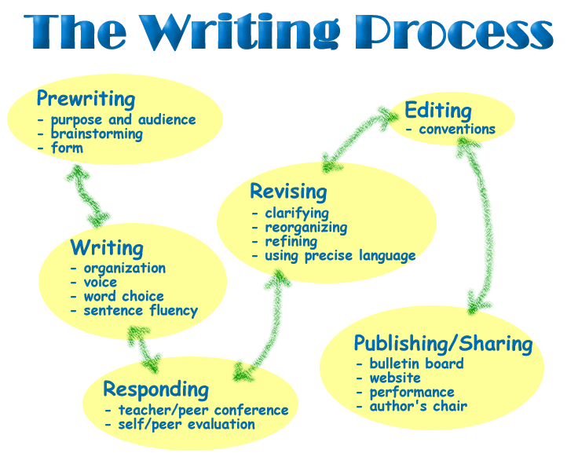


Some Samples of Classroom-based assessments
Writing – Graphic Organizer - What do you know about the writing process?
PE – Heart Rate Monitors -
Student-generated graphs, fitness
assessments over time, etc
Band – Performances . . . Individual
and group performance
Brainstorm some more examples in your groups

Slide 13
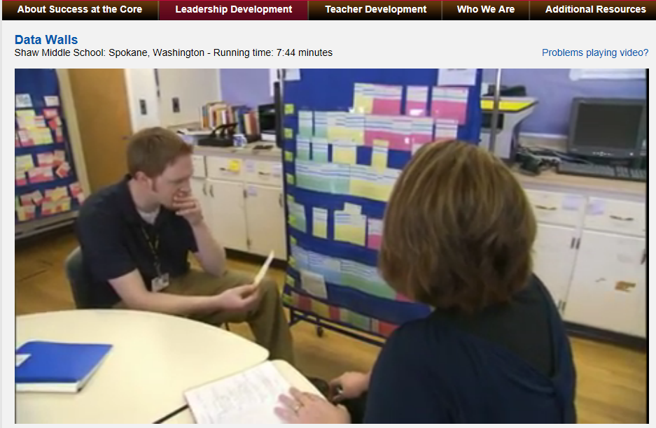
Data Walls Shaw Middle School in Spokane

Slide 14
Student Growth Data
Items | Local Decisions
Multiple Measures | Decide what measures are used in evaluation, Can include classroom based, school based, district based and state based assessments. Not required to use state test scores
Team’s student growth | Decide if team data should be used, what team data, how is it used, (must be appropriate and relevant) – examples: 4th grade team, math team, PLC team, school scores, etc.
Student Growth - “between two points in time” | Consider how long between the two points, formative vs. summative. Student achievement is not the same as student growth.
State test scores | Not required to use state test score. They are not calibrated and there is no vertical scale.
Value Added Data | Not required to use value added data . . . Not reliable enough for this purpose. Not valid for this purpose.
Student Growth Score | Triggers activities that could be bargained

Slide 15
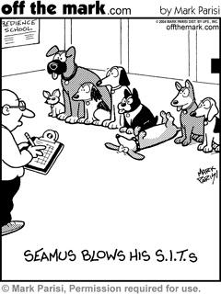
Thoughts? Questions? Reflections?

Slide 16
Value Added Models - Scenario 1
On average, did the students’ change in performance meet the growth expectation?
Difference between expected and actual is the “Value Add”
Expected Performance is based on statistical controls (Student characteristics, prior achievement, prior growth, etc)
Expected performance at a specified time
60%
53%
Starting Point
40%
4th Grade
2008
Same Students
5th Grade
2009

Slide 17
Value Added Models - Scenario 2
On average, did the students’ change in performance meet the growth expectation?
Students and Schools can show improvement but have valued added results that are negative.
Expected Performance
53%
46%
40%
Starting Point
4th Grade
2008
Same Students
5th Grade
2009

Slide 18








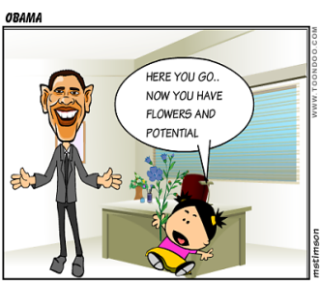

Teachers get a Percentile Score . . . In other words
Teachers are “normed” (ranked) and
placed along a continuum for the purpose of probation, firing, merit pay, etc.
25%
50%
75%

Slide 19
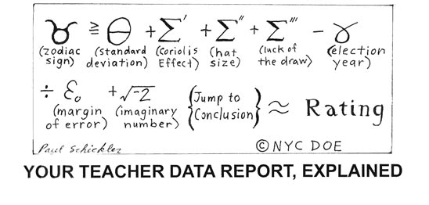
Value Added Calculation

Slide 20
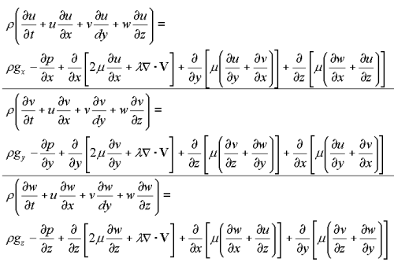
Teacher Effect Calculation

Slide 21
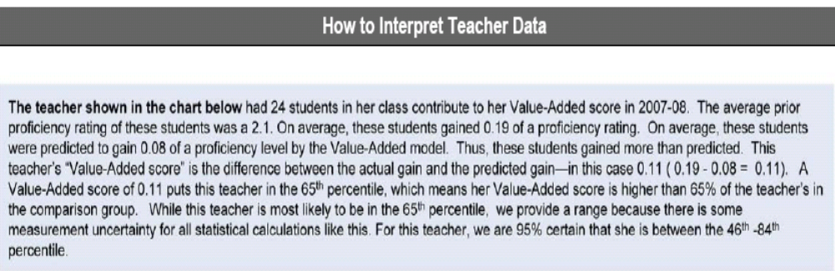
Excerpt from 2010 New York City Teacher Value Added Report
For this teacher, we are 95% certain that she is between the 46th and 84th Percentile.

Slide 22
Illusion of Precision and Accuracy
All value-added measures are estimates based on a statistical model
  Estimates are uncertain: They drive out a large “margin of error”
Ranking teachers requires precision and accuracy
  More reliable at the extreme ends of the spectrum
  More years helps

Slide 23
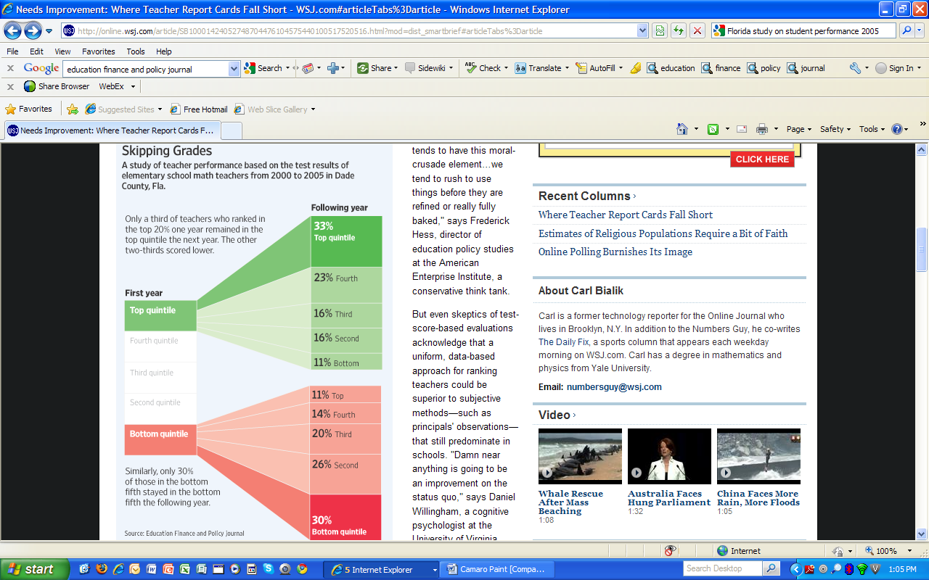
Reliability Results from a five-year study in Miami Dade County Florida
43% of the Teachers in the lowest three quintiles
45% of the Teachers in the highest three quintiles
Released: March, 2010

Slide 24
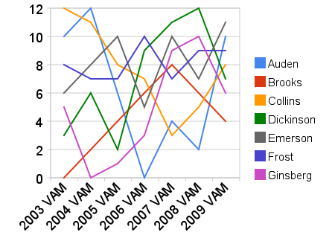

Slide 25

Perception Survey Data
Strengths to Consider
• Data from students who spend the most time
with teachers
• Can provide formative information to help
teachers improve practice
• Is another data point to support accurate
overall ratings
Cautions to Consider
• Student and teacher ratings have not been validated for use in final evaluations
• Students cannot provide information on all aspects of teaching
• Costs for data analysis and use can be intensive
• Bias of the respondents
• Students may “game” their responses to punish a teacher they don’t like, but
who may be a very effective teacher.”
• Accuracy of the respondents
• They only see one aspect of my teaching”
• Validity of the survey “Most of the surveys out there haven’t been developed
for use IN an educator’s evaluation.”

Slide 26
Perception Survey Data
Items | Local Decisions
Student Input may be used but not required (outlined in the law) | To what degree (if any), to what purpose (formative vs. summative) Little but some emerging positive data that supports some formative use. No requirement in the law.
Parent Input (law is silent on this) | To what degree if any, not determined to be a valid measure in current studies. No mention of this in the law
Peer Input (law is silent on this) | Having members of the same association contribute data towards a peers evaluation may not be considered appropriate. No mention of this in the law.
Teacher input to principal evaluation may be used (outlined in the law) | More credible evidence that supports this being a valid approach of data collection. Be careful with this one since most people will see it as an opening for parent/student/ perception data in teacher evaluations. Most people won’t take the time to understand the differences in validity and reliability.

Slide 27

Measures of Evidence A System of Evaluation
Self Assessment
Observations
Reflective Practice
Teaching Standards 8 Criteria
Artifacts
Impact on Learning
Plan Development
Goal Setting
Professional Contribution
Multiple Measures of Evidence drives performance Rating
Unsatisfactory | Basic | Proficient | Distinguished

Slide 28
Scoring Criteria Section 1, 2 (c) : Must score the 8 criteria and must use the four labels (Unsatisfactory, Basic, Proficient, Distinguished) Local decision on how to get from the components to the criteria score
Criteria | Unsatisfactory | Basic | Proficient | Distinguished | Score
Criterion 1 |  |  |  |  | Basic
Component 1 |  | X
Component 2 |  |  | X
Component 3 |  | X
Criterion 2 |  |  |  |  | Proficient
Criterion 3 |  |  |  |  | Proficient
Criterion 4 |  |  |  |  | Proficient
Criterion 5 |  |  |  |  | Distinguished
Criterion 6 |  |  |  |  | Proficient
Criterion 7 |  |  |  |  | Distinguished
Criterion 8 |  |  |  |  | Basic
Final Score | Proficient

Slide 29
Instructional Framework
Final Summative Score Section 1, 2 (c) : OSPI adopt rules prescribing a common method for calculating the final summative score (including focused evaluation), consider weighting criteria and maximizing rater agreement across the three frameworks.
Three Instructional Frameworks Section 1, 2 (e) : Sept 1, 2012, OSPI determine three research-based instructional frameworks.
(No waivers but process for minor modifications)
Charlotte Danielson Model
Robert Marzano Model
U.W. CEL 5 Dimensions + Model
Danielson
U.W CEL 5D+
Marzano

Slide 30
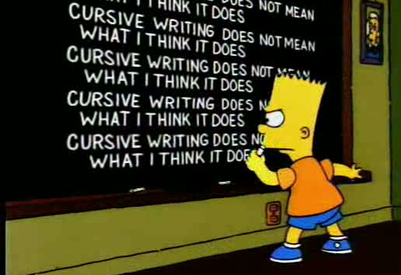
Cut Line for Unsatisfactory
Not Deemed Satisfactory / Change of Cut Line Section 1, 4 (a)
Level 1 – Unsatisfactory for those with five or fewer years of experience
Level 2 - Basic - If the classroom teacher is on a continuing contract with more than five years of teaching experience and if the level 2 has been received two years in a row or two years within a consecutive three-year period.
Possible bargain around the kinds and level of supports needed if a teacher gets on a trajectory of non-renewal

Slide 31
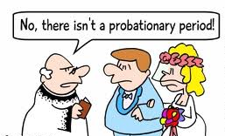
Probationary Period
Probationary Period - Section 1, 4 (b)
A probationary period of 60 school days
Days may be added if deemed necessary to complete a program of improvement as long as the probationary period is concluded before May 15
Probationary period may be extended into the following school year if the probationer has five or more years of teaching experience and a final summative rating as of May 15 of less than level 2
Any time you see the word “may” think about how it could be bargained.

Slide 32

Phasing in the New Evaluation System
Phase in of New System - Section 1, 7 (c)
Must start new evaluation system by 2013 – 14 school year and be fully operational by 2015-16 school year.
All provisional and probationary classroom teachers on comprehensive evaluation first year and beyond.
Bargain phase-in and rotation as long as everyone receives a comprehensive evaluation by the 2015-16 school year but be careful of unintended consequences i.e. two systems at the same time

Slide 33
Need to consider what happens with a two system approach
Comprehensive Evaluation Focused Evaluation Long form Short form PGO Two tiered system Four tiered system Some on an instructional framework Some on no framework Some teachers working together for a score Some not working together | Some receiving a final score one way Some receiving a final score another way Two different triggers for probation in the same school/district Two kinds of supports - In one system, request an external evaluator and it must be granted, in the old system, it doesn’t

Slide 34

ESSB 5895: Language In New Evaluation Bill
Principal Training - Section 2,2 and Section 3,2
Principals must be trained on the new evaluation system before implementing the new system. Professional development must include inter-rater agreement training.
Are there bargaining implications around this? What are the issues?

Slide 35


ESSB 5895: Language In New Evaluation Bill
Human Resource Decisions - Section 1, 8 (a)
Human Resource Decisions: Beginning in the 2015-16 school year, evaluation results must be used as one of multiple factors in making human resource and personnel decisions.
“Nothing in this section limits the ability to collectively bargain how the multiple factors shall be used in making human resource or personnel decisions, with the exception that evaluation results must be a factor.”

Slide 36


ESSB 5895: Language In New Evaluation Bill
Comprehensive Evaluation Section 1,12 (a) (b)
All classroom teachers shall receive a comprehensive summative evaluation at least once every four years. The comprehensive evaluation assesses all eight evaluation criteria and all criteria contribute to the comprehensive summative evaluation performance rating.
Who gets a comprehensive evaluation?
All provisional classroom teachers
Any classroom teacher not on level 3
Classroom teachers on level 3 or above once every four years

Slide 37

ESSB 5895: Language In New Evaluation Bill
Focused Evaluation (previous PGO) Section 1,12 (c)
If not on a comprehensive evaluation and if scored a 3 or better the previous year, teachers are required to complete a focused evaluation. Have to select one of the eight criteria and have professional growth activities linked to the selected criteria.
Must be approved by the principal
Group of teachers may focus on same evaluation criteria and share professional growth activities
Can be transferred back to comprehensive evaluation at the request of either the teacher or principal
Anyone currently on a PGO may rollover into the new system and comply with all new evaluation requirements

Slide 38

Provisional Status
Provisional Status - Section 7, 1 (b)
Teacher who has received an evaluation rating below level 2 on the third year of employment shall remain on provisional status until the teacher receives a level 2 or higher or dismissed.

Slide 39
Removed from Probation
Removed from Probation/Discharge - Section 1, 4 (b) (c) (d)
Must be removed from probation if shows improvement to the satisfaction of the evaluator in the areas prescribed as deficient.
Must be removed if a teacher with 5 or fewer years of experience scores a level 2 or above and a teacher of more than five years scores a level 3 or above.
Continuing contract employee with 5 or more years of experience receives a final summative score below level 2 (level 1) for two consecutive years, the school district shall implement the employee notification of discharge.
If no improvement during the probationary period, the employee may be removed from current assignment and placed in alternative assignment or paid leave of absence.

Slide 40

Request for Support
Probation - Request for Support - Section 1, 4 (b)
The probationer may request that an additional certificated employee evaluator become part of the probationary process and the request must be granted.
Assigned by the ESD and selected from a list of evaluation specialists compiled by the ESD
If procedure error occurs, it does not invalidate the probation unless the error “materially affects the effectiveness of the plan or ability to evaluate the probationer’s performance.”

Slide 41

Going to have to find Infinite Energy to pull this off
v
v
v
v

Slide 42


Summary . . . Consolidating the Information

Slide 43
Summary - Language In New Evaluation Bill
Student Growth Data: Used in at least three of the eight teacher and principal evaluation criteria. Can include the teacher’s performance as an individual or as a member of a team. Did not require state test scores . . . only student growth
Student, Teacher, and Parent Input: May be included but not required. Local decision and bargainable
Phase in: Must start by 2013-14 and must be completed by 2015-16 School year
Scoring: Must score the 8 criteria and must use the four labels (Unsatisfactory, Basic, Proficient, Distinguished)
Cut Line: After five years in the system, must be proficient. Two years in Basic or below or two out of three years equates to not being satisfactory.
Final Summative Score: OSPI develop a common method for calculating the summative score
Frameworks: Three frameworks for teachers and principals

Slide 44
Summary - Language In New Evaluation Bill
Waivers: No waivers . . . .OSPI has the ability to accept minor adjustments
Pilots continue work: (Implementation issues, refine system tools, practices, student growth data, recommendations, HR and personnel decisions, etc)
Frequency:
All teachers and principals must receive a comprehensive evaluation at least once every four years.
New teachers and principals (first 3 years) must receive an annual comprehensive evaluation as well as principals who are in their first full year at a new school district.
Teachers or principals receiving a Level 1 or Level 2 rating in the previous year must receive an annual comprehensive evaluation.
Focused Evaluation (Professional Growth Option): A focused evaluation must be performed in any year that a comprehensive evaluation is not scheduled. (both teachers and principals)

Slide 45
Summary - Language In New Evaluation Bill
Human Resource Decisions: Beginning with the 2015-16 school year, evaluation results for certificated classroom teachers and principals will be used as one of multiple factors in making human resource and personnel decisions.
  staff assignment, reduction in force, transfer
  Evaluation results must be a factor but details go through the collective bargaining process
Professional Development & Training
Principals and administrators must receive professional development prior to evaluating teachers and principals

Slide 46


Questions

Slide 47
Teacher and Principal Evaluation Local and State Decisions
Items | State Decisions | Local Decisions | Notes
New Evaluation System ESSB 5895 28A.405.100 | Defined by state | No changes to ESAs and classified staff evaluation . . . continue to locally bargain | For Classroom teachers and building principals and assistant principals. Does not impact ESAs and Classified staff
Adoption Date and Transition Section 1, 7 (c) | All districts must begin implementation in 2013-14 school year and be fully implemented by 2016 |  | Requires provisional or probationary teachers, and principals with fewer than 3 years of experience, unsatisfactory performance, or new to the district to be transitioned first. Nothing prevents earlier transition.
Criteria Section 1, 2 (b) | Defined by state 8 Criteria (Principal and Teacher) Must score the 8 criteria |  | Must use exact wording and labels (unsatisfactory, basic, proficient, distinguished). Evaluations assess all 8 criteria

Slide 48



FAQ on Teacher Evaluation
This document is in response to questions that we received at evaluation trainings throughout the year. We will continue to update this document as information is clarified. Please don’t hesitate to contact us if you have additional questions or concerns about teacher evaluation in your district.
What student growth data is used in the new evaluation systems?
How will a final summative score be calculated?

Slide 49

eVAL Washington

Slide 50
Sandbox
The link to the sandbox is: http://sandbox.eval-wa.org
Login is:
District Administrator: Everett sd da
District Evaluator: Everett sd de
District wide teacher evaluator: Everett sd dw
Building administrator: Everett sd school 1 ad
Head Principal: Everett sd school 1 hp
Principal: Everett sd school 1 pr
Teacher: Everett sd school 1 t1
The password for each roles is: password
There are 20 teachers and they are differentiated by t1, t2, t3, etc.
There are 5 schools in each school district differentiated by school 1, school 2 etc.

