Slide 1
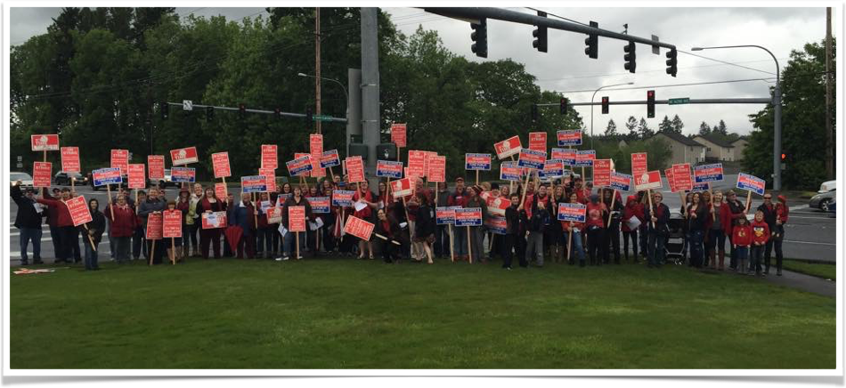
HEA General Meeting
May 18th, 2016
Please sign in at the table.
Pick up your raffle ticket.
Grab a ballot and survey.
Enjoy the food!

Slide 2
Welcome!
Thank you for attending!
Everyone please sign in and grab the following:
  Ballot
  Bargaining Survey
  Raffle Ticket - drawing at the end of the meeting

Slide 3
Constitution and Bylaws
Vote whether or not to approve new Constitution and Bylaws - turn in at end of meeting
Copies of proposed language was sent via email
  Paper copies can be viewed at table
New documents will help HEA run more efficiently and transparently.
  Written by HEA officers with help from WEA-Riverside and WEA legal.
  Clear job descriptions for officers.
  Policies and procedures for important tasks - voting, timeline for accomplishing important tasks, checks and balances.
  Updated language to reflect current education climate.

Slide 4
Officer Elections
Please fill out ballot and turn in at end of meeting
Nominees
  Co-Presidents: Corey McEnry/Megan Miles
  Vice-President: Anna-Melissa Lyons
  Secretary: Nancy O’Neill-Bratt
  Treasurer: Ketti West
  Building Representatives:
    High School: Angela Redinger and (?)
    Middle School: Kim Abegglen and (?)
    Elementary School: Mary Koenig and (?)
Please consider serving on a committee next year
  More member involvement = less work for individuals

Slide 5
Contract Negotiations
HEA Negotiations Team
  HS: Corey McEnry and Angela Redinger
  MS: Anna-Melissa Lyons and Ketti West
  ES: Tara Bellikka and Megan Miles
Contract expires August 31, 2016
HEA and District’s scheduled negotiation dates
  June 14, 15, 16 (4-8pm)
Please fill out negotiations survey and return by end of meeting
  Choose your priorities for financial items
  Feel free to add other comments to bottom of survey

Slide 6
How Do We Compare?
Local | TRI Pay | Class Size | Health Insurance | SPED Case Load
Hockinson | 2015-2016: 11% | K=22, 1=23, 2=24, 3=25, 4-5=28, 6-8=30 (max 140 students), 9-12=32 (max 150 students) | District pays $10/month Employee pays $10/month | No language
Battle Ground | 2015-2016: 11.7% General Ed Teachers, 8.9% All Others 2016-2017: 12.8% GET, 10% AO | K-4=25 5-8=28 9-12=36 (max 150 students) | Employee pays 1.6% | Resource: 27 Self Contained: 10 Self Contained “Severe”: 8 BD: 14
Camas | 2015-2016: 14% 2016-2017: 17% | K-5=24 6-8=30 9-12=31 | District pays $10/month Employee pays 2% | K-5: 30,12,10,8 6-8: 30,16,12,12 9-12: 32,16,12,16 RR,SIS,LS,BD
Evergreen | 2015-2016: 15.25% 2016-2017: Negotiating | K-3=23/26, 4-5=25/28, 6=28/30, 7-8=30/32, MS electives 29/32, 9-12=30/33 (Average/max) | Employee pays 2% | LS Elem=26, LS MS=28, LS HS LS=30, ALC=14, LSC=9, DSC=7, ECC=18, SCIP=10, K-1=14, Transition=7-14, SLC Elem=11, SLC Sec=15, DHH=9, Day Treatment=7
Ridgefield | 2015-2016: 10%+$700 2016-2017: 11.5%+$700 2017-2018: 14%+$700 | K=22, 1=23, 2=24, 3=25, 4-6=28, 7-8=30 average, 9-12=31 average | District pays $13/month Employee pays 1% | ESD
Washougal | 2015-2016: 8%+$730 2016-2017: 10%+$730 | 2015: K-3=25, 4-8=28, 9-12=28 | No language | 2015: “Reasonable caseloads”, employee right to petition for lower caseload

Slide 7
Climate Survey
Presentation by Kim Abegglen
  Members can view paper copies of the data and read verbatim comments by visiting their building rep.
  Superintendent will receive a complete copy of the data and general comment themes
  Administrators will receive a copy of the data for their building and general comment themes

Slide 8
HEA Does Good Things!
Recent issue at HHES involving a man open-carrying a gun on campus
  Law is unclear on how citizens with concealed-carry permits can carry weapons on school property
  Members and law enforcement are concerned about this potentially dangerous situation
HEA officers helped facilitate meetings between WEA and our SRO, Jason Granneman
WEA was unaware of this problem before we brought it to their attention, but will now be partnering with Officer Granneman and WACOPS to lobby legislature to fix this law
  Local legislators have already pledged to help fix the law

Slide 9
  End of Year Celebration
Friday, 5/20
6:00-7:30pm
The Cedars
Honor our retirees!
All HEA/ESP invited!
Appetizers provided!
Please help spread the word!
Thanks to our Social Committee!

Slide 10
Before You Go
FIRST 60 PEOPLE TO DO THE FOLLOWING GET A CHANCE TO WIN SOME $$$
  Make sure you signed in
  Turn in Constitution/Bylaws ballot
  Turn in Officer ballot
  Turn in Negotiation Survey
Do we have your home email address? If not, see Nancy O’Neill-Bratt
Stay in touch online
  www.hea98.com
  www.facebook.com/groups/hea98
Please feel free to stick around and visit or ask questions!
THANK YOU FOR YOUR SUPPORT!

